Slide 1


Slide 2
Relational Databases
Zach Merrill, Systems App Developer - Gallup

Slide 3
Agenda
What is a database?
Relational Database Basics
SQL
Database Design
Project

Slide 4
What is a Database?
Relational Databases

Slide 5
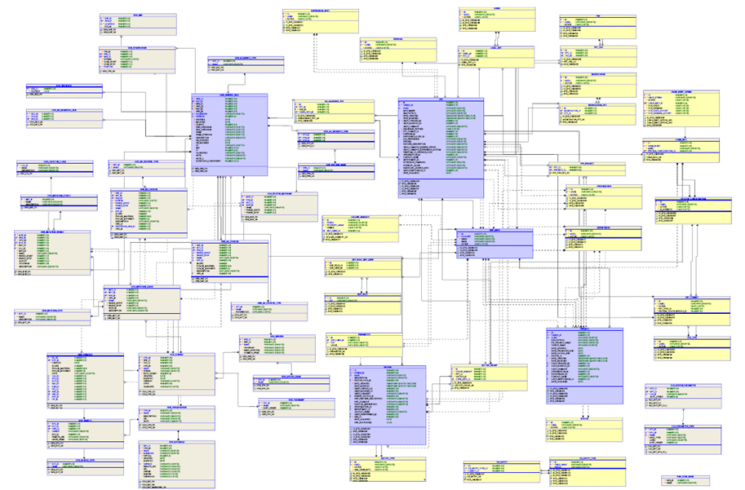
What is a database?
A collection of data stored in a physical location in memory
Data is organized to model reality, similar to OOP
Databases are used in nearly every discipline of software development

Slide 6
What kinds of databases are there?
Relational Model
Very common database model
Three main parts: relations, attributes and domains
Relations are the tables with each row representing a set of data
Attributes are the columns of the table, each with a unique name
Domains are the values the attributes are allowed to have (also called constraints)
A relational database consists of many tables
Each table can be linked by common attributes, called keys
Keys can also be used to imply uniqueness

Slide 7
What kinds of databases are there?
Dimensional Model
Less common adaptation of the relational model
Typically there is one large table surrounded by many smaller tables that describe the entities in the large table
There can be many of these star structures in a dimensional database
Used most often in analytical processing and data warehousing for business intelligence (think targeted coupons)

Slide 8
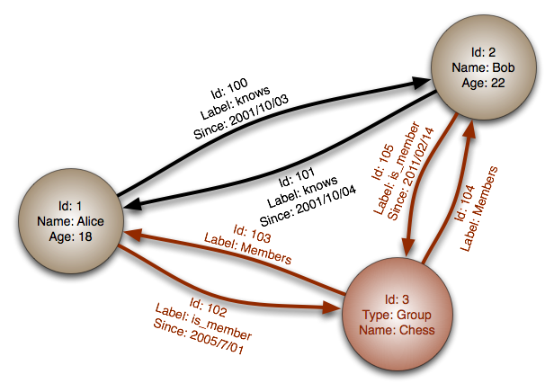
What kinds of databases are there?
Graph Databases
Based on graph theory
Uses nodes and edges to represent data and the relationships between them
Any two nodes can have a relationship
Used in huge databases where fast lookup is critical (Twitter, Facebook)

Slide 9
How do we use Databases?
Humans can use a Database Management System (DBMS) to create, read, update and delete data directly from a database
Popular DBMSs include MySQL, PostgreSQL, Microsoft SQL Server and Oracle
Our applications need to have a network connection to a database
Databases will open a port that allows data to be transferred in and out
Software developers are responsible for writing the code that connects to a database

Slide 10
How do we use Databases?
A database can be embedded in an application itself (very common on smaller mobile applications) or it can be stored on an external server
Databases on a server have multiple options for connection. An application can connect directly through an open port, or a developer can create an Application Programming Interface (API)
These APIs can be interacted with through URLs , which is very useful for web and mobile applications

Slide 11
Relational Database Basics
Relational Databases

Slide 12
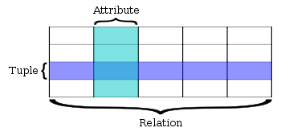
Relational Database Basics
Each database is a collection of related tables
A table is a representation of an entity or object consisting of columns (attributes) and rows (record)

Slide 13
Relational Database Basics - Keys
A two tables can have one of three types relationship
One-to-one relationships imply that a record can have one and only one related record
One-to-many relationships imply that a one record can have many related records, but each of those can only belong record. This is a hierarchical, or parent-child type of relationship
Many-to-many relationships imply that a record can be related to many other records and each of those can be related to many records. Typically accomplished with a intermediate table

Slide 14
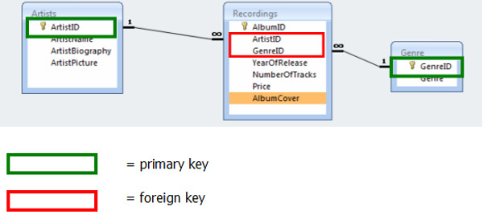
Relational Database Basics - Keys
We use keys to represent and enforce those relationships
Primary keys – uniqueness, db assigned
Alternate keys/natural keys – uniqueness
Foreign Keys – relate two tables

Slide 15
Relational Database Basics - ACID
Every database must adhere to the ACID properties
Atomicity – each transaction is all or nothing
Consistency – each transaction must leave the db in a valid state (foreign key removal)
Isolation – each transaction is independent of another transaction
Durability – all changes to the db are stored permenantly, in non-volatile memory

Slide 16
Relational Database Basics
The are four main interactions a user can perform on a database
Create – create a new row in a table
Read – query rows to view
Update – set values in an existing row
Delete – delete a row
These are known as the CRUD operation
Provide a foundation for data in an application

Slide 17
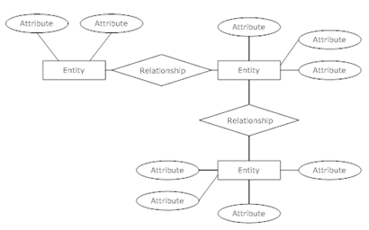
Entity-relationship Diagrams

Slide 18
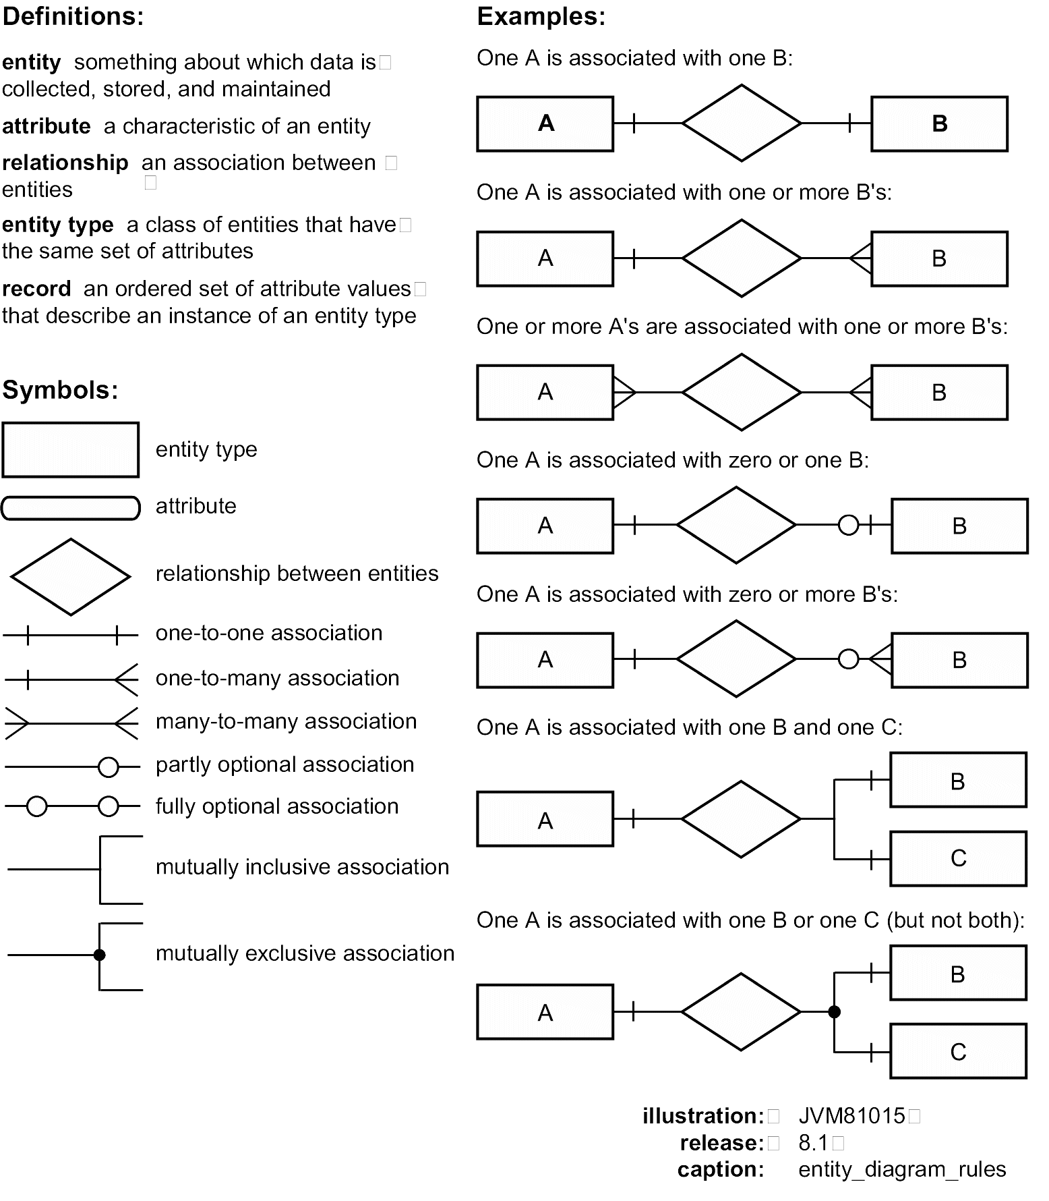

Slide 19
SQL
Relational Databases

Slide 20
SQL
SQL or the Structured Query Language is the language we use to communicate with a database
Although the language itself is very complex, most operations are CRUD
There are four main keywords that correspond to the CRUD operations: INSERT, SELECT, UPDATE and DELETE
Other important keywords
FROM
WHERE
ORDER BY
JOIN
AND, OR
Many others

